Slide 1
Session 2: Structuring an Impactful Data Story
Data Literacy & Process

Slide 2
Data can usually be bucketed under 4 types:
Data
Quantitative
Discrete
Continuous
Categorical
Nominal
Ordinal
Based on counts
Whole numbers
Results of Die roll (1, 2, 3, 4, 5, 6)
Apples in a tree (5, 10, 20, 50..)
Based on measure
Can take any value in a range
Stock prices ($9.5, $10.0)
People weight (70 kg, 91.5 kg)
Doesnt have an intrinsic order
Can be numeric (Pincodes)
Political parties (INC, BJP..)
Vegetarian (Yes, No)
Has a natural order
Can be numeric
Grades (A, B, C, D)
Client feedback
(Unhappy, Happy)

Slide 3
Data Relationships
Comparison- Simple comparison of the quantitative values of subcategories.
Time Series - Tracks changes in values of a consistent metric over time.
Correlation - Two or more variables that may demonstrate a positive or negative correlation to each other.
Ranking- How two or more values compare to each other in relative magnitude.
Distribution - This shows data distribution, often around a central value.

Slide 4
Data Relationships
Outliers - A variable that is an abnormal distance from other variables.
Variability/Standard Deviation: This examines how data points relate to each other, particularly how far any given data point differs from the mean.
Mean - The sum of all variables divided by the number of variables.
Range - The difference between the highest and lowest variables in your data set
Part-To-Whole - This shows a subset of data compared to the larger whole. This is used to show things like proportion or percentages.

Slide 5
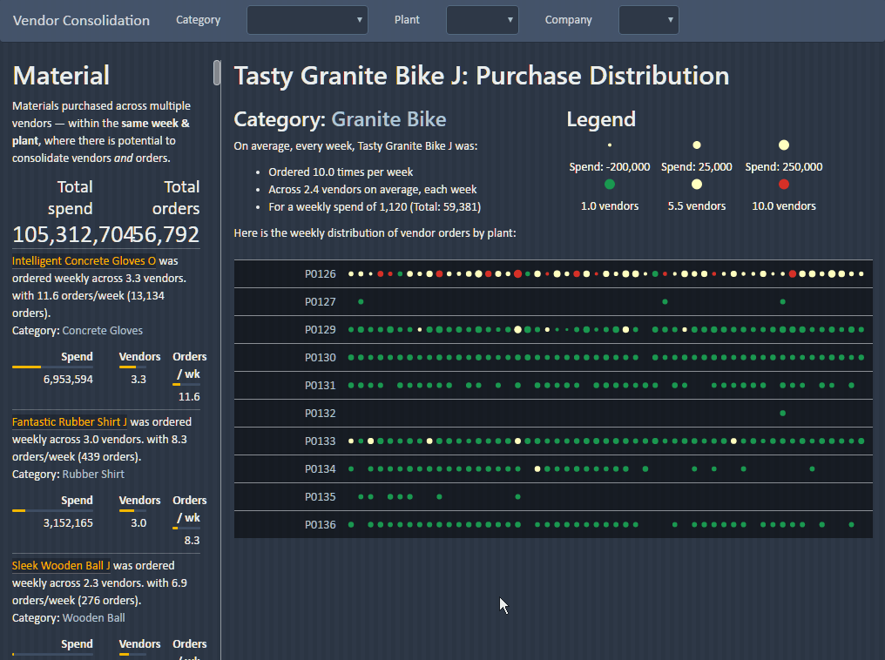
European brewery identified €15 m cost savings after consolidating vendors
A leading European brewery’s plants purchased commodity raw materials from several vendors each – and had low volume discounts.
Plants also placed multiple orders placed every week, leading to higher logistics cost.
Gramener built a custom analytics solution that showed how each plant performed compared to peers – shaming those with poor performance.
With this, they identified savings of €15 m — which the plant managers couldn’t refute.
€15 m
40%
savings potential identified annually
vendor based reduction identified
Notes:
A leading European brewery’s plants purchased commodity raw materials from several vendors each – and had low volume discounts.
Plants also placed multiple orders placed every week, leading to higher logistics cost.
When plant managers were shown the data, they objected, saying “That’s not always the case.” Or, “That’s the only way– no one else does better.”
Gramener built a custom analytics solution that sourced their SAP order data, automatically identified which plants ordered which commodities the most from multiple vendors – and when.
It showed how each plant performed compared to peers – shaming those with poor performance.
With this, they identified savings of €15 m — which the plant managers couldn’t refute.

Slide 6
Global airline reduced cargo turnaround time by 15% with scenario modeling
This slide is best viewed in slideshow mode. The animations tell a story that isn’t obvious on the static version.
A global airline company took up a service level agreement to deliver cargo from the flight to the warehouse in under 1.5 hours. This target was 15% lower than their current best.
Several factors affect cargo delay across airports. Availability of forklifts, staff size, cargo type, part shipment, and many others. Altering any of these is expensive and takes long.
Gramener built a visual analytics solution that showed where cargo was delayed.
This allowed the airline to reduce the turnaround time by 15% from 1.76 hrs to 1.5 hrs. The worst-case turnaround time also reduced by 34% from 2.9 hrs to 1.92 hrs.
Recovery times are neutral during the evening and morning shifts (mornings are slightly worse), night times are the best.
Evening
Morning
Night
Shift
Specifically, Friday mornings are particularly bad.
So are Thursday mornings.
Recovery times are worst on Fridays, and best on Saturdays & Wednesdays.
Fri
Mon
Sat
Sun
Thu
Tue
Wed
Weekday
However, RPP on Sundays is unusually slow.
The FAH product category has the best recovery time, while ZDH is much worse.
FAH
N70
RPP
TDS
ZDH
Product category
15%
34%
This is especially problematic for ZDH
Part shipped products tend to perform worse than full-shipments. Specifically the <20% and 40-60% part-shipments.
cargo turnaround time reduction (from 1.76 to 1.5 hrs)
reduction in worst-case turnaround time
20-40%
40-60%
60-80%
<20%
Full
Part shipment
See live demo

Slide 7
Understand the audience & intent
You have data.
You have analysis.
Now, narrate your story.
Find insights
Storyline
Design data stories

Slide 8





Who is your audience? They determine the story
What’s the topic? Why is it important? What will you learn now?
Different people want different things from the same data.
Given sales data:
The Board: “Predict next quarter’s sales”
Product head: “Which product grew the most?”
Sales head: “Did we meet our target?”
They are not interested in each others’ questions.

Slide 9

What is their problem? That defines your analysis
How can the audience practice this?
For each person, answer the following questions:
What’s their situation?
What problems do they face?
What action can they take?
What is the impact of this action?
Example
John, the Marketing head, person, role must create a region-wise budget, situation and doesn’t know where to focus. problem By prioritizing the region, action he can maximize ROI. impact

Slide 10
Here are two examples in real life
 | Purchasing Commodities | Cargo Delay
Person, Role | Adam, the purchasing head of a leading European brewery | Christina, the operations head of a leading US airline
Situation | had plants that purchased commodities from several vendors. Discounts were low. Number of weekly orders were high. | had an SLA to deliver cargo from the flight to the warehouse in under 1.5 hours – 15% lower than their current best performance.
Problem | But he didn’t know which plants and commodities were a problem. Every plant denied it. | But she didn’t know what were the biggest drivers of this delay – people, assets, or type of cargo.
Action | By consolidating vendors and reducing order frequency, | By adding resources only to the largest levers of delay,
Impact | they could increase their discounts and reduce logistics cost. | she could reduce turnaround time with the lowest spend.

Slide 11
Filter for big, useful, surprising insights
What’s the topic? Why is it important? What will you learn now?
Is the insight
Big
We want a result that substantially changes the outcome.
Example | B | U | S
There are twice as many restaurants in NYC than any other city | ✓ | ✓ | ✗
Sales increased in every region except our largest branch, which dipped by 0.1% | ✗ | ✓ | ✓
Increase in rainfall increases the sale of umbrellas, and is the biggest driver of our sales | ✓ | ✗ | ✗
Is the insight
Useful
Can they take an action that improves their objective?
What should they do next?
Is the insight
Surprising
Is it non-obvious?
Does it overturn an existing belief, or bring consensus?
Filter the analyses using this checklist
Notes:
Think of good anecdotes here

Slide 12
Here are the analyses & filters for the problems we saw earlier
Purchasing Commodities | B | U | S | Cargo Delay | B | U | S
The most common commodity was ordered 10 times a week across 2.4 vendors |  |  |  | Fragile cargo is a big factor in the delay, with a 20% impact
The number of orders is correlated with the number of vendors. Reducing one will reduce the other |  |  |  | Fridays are when cargo is delayed the most
Plant P126 was the plant with the most violations, especially on largest commodity |  |  |  | Trained staff and forklifts impact delay the most

Slide 13
Here are the analyses & filters for the problems we saw earlier
Purchasing Commodities | B | U | S | Cargo Delay | B | U | S
The most common commodity was ordered 10 times a week across 2.4 vendors |  |  |  | Fragile cargo is a big factor in the delay, with a 20% impact | B |  | S
The number of orders is correlated with the number of vendors. Reducing one will reduce the other |  | U |  | Fridays are when cargo is delayed the most | B
Plant P126 was the plant with the most violations, especially on largest commodity | B | U |  | Trained staff and forklifts impact delay the most | B | U | S

Slide 14
Storylines are plot outlines. They summarize the entire story
What’s the topic? Why is it important? What will you learn now?
Gladiator’s storyline
The Emperor asks General Maximus to take control of Rome and give it back to people
The ambitious Prince murders the emperor.
Maximus is sold as a gladiator slave. His family is murdered
Maximus grows famous, fights the Prince in the arena, and wins
He joins his family in death. Rome is in the hands of the people
A business storyline
Our NPS improved 6%
It was 34% in 4Q18. Now it’s at 40% in 2Q19
Despite lower satisfaction with our Support, our NPS grew
This increase in NPS was mainly due to better Product Quality & Research
Notice “characters” in red. All stories have characters, human or otherwise.
Outlines are the backbone on which you flesh out your story. This section explains how to create storylines

Slide 15
1. Start with the takeaway (The elevator pitch. The moral of the story.)
What’s the next step? How can the audience practice it?
Close your eyes. Think of a childhood tale. Summarize the moral of the story in one line
We easily we remember these stories and their summary as a moral several years later.
Close your eyes. Think of a business presentation from last week. Can you easily summarize the message in one line?
Stories are designed around a moral. A single takeaway. An “elevator pitch”
DO IT: Write your takeaway as one sentence
What’s the one thing you want the audience to remember from your story?
What’s the one message that the audience should take away?
CHECK IT: Verify these yourself
Is it a single, complete, sentence?
Does it deliver what you want the audience to remember?
Will your audience care a lot about this?
It’s a one-sentence summary of the most important message for the audience.
Notes:
Instructors: Give the audience 1 minute to write down a one-sentence takeaway. Ask 2 people to read it out. Apply the checklist. If they don’t meet the checklist, prompt them to revise it. Allow them to struggle through it before taking help.

Slide 16
2. Find analysis that supports your takeaway. Ignore irrelevant content
What’s the next step? How can the audience practice it?
What supports your takeaway from “The Lion and the Mouse”?
http://www.read.gov/aesop/007.html
The lion was an Asiatic lion
The lion had a huge paw
The lion spared the mouse it caught
The lion was caught by a hunter’s net
It was stalking its prey when it got caught
The mouse was nibbling grass nearby
The mouse took few minutes to cut the net
DO IT: Write your supporting analysis
List all possible analysis
Re-word them as sentences
Strike off what’s not relevant
CHECK IT: Verify these yourself
Is each necessary? Does each analysis support the takeaway?
Are they sufficient? Do the analyses prove the takeaway?
There’s no right or wrong answer. Think about how it supports your takeaway.
Only include analysis that proves the takeaway. Ensure that they fully prove the takeaway.
Notes:
Instructors: Give the audience 2 minutes to write down supporting material. Ask 1 person to read it out. Apply the checklist. Debate with them whether each point is necessary: “How does it support the takeaway?” Check if the analyses, when put together, logically prove the takeaway. There must be no alternative conclusion possible. If not, we need additional material to prove the takeaway.

Slide 17
3. Convert analysis into messages by adding context
What’s the next step? How can the audience practice it?
Analysis doesn’t mean anything to people. When it does, it’s a message. We do this by adding context. Three ways to add context are:
Compare with similar numbers. Our $15 mn sales is $3 mn more than last year, $1 mn below budget, and twice our nearest competitors.
Explain with analogies. If we stopped producing, it’ll take 3 months to dispose our excess inventory of $2 mn.
Add business interpretation. Usage is correlated with discounts. For every $1 discount, customer LTV increases by $24.
DO IT: Add context to your analysis
Take each relevant analysis
Convert it to a message for the audience by adding context
CHECK IT: Verify these yourself
Will your audience understand the messages without explanation?
Will your audience understand why this message is relevant?
Frame each analysis as a message that the audience will understand and find relevant
Notes:
Instructors: Give the audience 2 minutes to expand on the context for any one analysis. Ask 1-2 people to read it out. Apply the checklist. Debate with them how they could make the point clearer and meaningful to the audience.. Explore alternatives, using comparisons, analogies or interpretation.

Slide 18
4. Structure the messages into a pyramid or a tree
What’s the next step? How can the audience practice it?
Construct a pyramid or tree-like outline
Start with the takeaway at the root of the tree
Add a message that supports the takeaway
Add further details or supporting messages
Messages must prove the first message, and only the first message
Strike off any message that isn’t required to prove or support the takeaway
Add next message that supports takeaway
Add details to prove the second message
Remaining messages for the takeaway
Add details as required
Example of a business tree
Launch sales were 30% less than target due to high competition
Launch sales were projected at $20 mn in the first month, but achieved only $14 mn
Sales in every region were 20-50% lower.
Only Philippines & Korea were on target
Competitors discounted price by 35% - which is unsustainable for them
80 store discounts increased from 15% to 35%
The maximum sustainable discount is 20%
Stores offered higher discounts saw less than 20% of our target sales
Arrange messages hierarchically to prove & support the parent message
Notes:
Instructors: Ask 1-2 people from the audience to add supporting points to their takeaway or any message. Ask others to debate whether these points are necessary and sufficient to prove the parent message. Ask the audience if some of them are sub-bullets to a supporting point.

Slide 19
5. Re-order the messages to increase memorability and motivation
What’s the next step? How can the audience practice it?
Structure your supporting messages into a memorable flow. Here are 7 flows that help:
Time: e.g. Past, Present, Future Sales was $15 mn. Now it’s $18 mn. We expect it to grow to $20 mn.
Place: e.g. NA, EU, APAC
Aspects: e.g. company, competition, context
Benefits: e.g. better, faster, cheaper
Scale: e.g. local, regional, global
Balance: e.g. pros, cons
Priority or climactic: least to most important
Order messages into an emotionally contrasting, motivating sequence.
Take this aspects-based flow:
Our profits doubled. But our sales only grew 20%. Our gross margins stayed flat.
The “emotional arc” is falling, and not motivating.
Here’s the same message re-ordered:
Our sales grew mildly at 20%. Our margins didn’t improve at all. But our profits doubled!
This emotional arc falls before rising. This is more motivating.
Remember: Emotional contrast requires bad news – it makes good look better
Notes:
Instructors: The emotional arc is an interesting device and can attract questions. Clarify a few points. It’s not a graph of the data. It’s a graph of the EMOTION the graph triggers. There’s no right or wrong level to the emotion arc. It’s subjective, and audience driven. It’s important to ensure high contrast, and end with the feeling you want to deliver. That’s all. What most people are afraid to do is deliver bad news. Encourage the audience to deliver bad news as a vehicle to make the good news look better. Practice this by asking people for examples of related good and bad news. Then ask how they would word it so that the good news looks better.
For example, “Sales fell. Margins improved” can become “Despite lower sales, our profits have not worsened proportionally, thanks to a significant improvement in our margins.”

Slide 20
Here is the storyline for the analyses we saw earlier
 | Purchasing Commodities | Cargo Delay
Takeaway | Focus on reducing the number of vendors products ICG (in P126), FRS (in P121) and SWB (in P074) for a potential 40% reduction in logistics & vendor cost. | To reduce the TAT to 1.5 hours at Airport XYZ, increase the number of forklifts from 1 to 2, and the number of trained staff from 4 to 6
Supporting points | ICG spend is among the highest, at €6.9m. P126 typically orders 40 times a week, often from 15-20 vendors. | The number of forklifts is the biggest driver of TAT. Each forklift typically reduces TAT by 15-30%.
 | FRS spend is €3.2m. P121 orders from 3 vendors 8-14 times a week. | Total staff count does not impact TAT. Increasing trained staff has a more tangible impact of ~5-10% per person.

Slide 21
Session 3: Designing an Effective Data Story
Understanding visuals

Slide 22
Pick a format based on how your audience will consume the story
What Format should you use for your data story ?
Is there one main story that you want to narrate?
Will someone narrate the insights?
No, audience will consume on their own
Will the audience need to interact?
Seen on digital devices or printed?
Static Slides
Yes, there is
a presenter
No, interactivity
needed
Digitally
consumed
Videos/
Infographics
Yes
No, it will be based on
audience questions
Yes, audience should be able to filter or drill down
Printed
Interactive Slides
Yes, there is
one main narrative
Is there one main story that you want to narrate?
Put up in a shared space
Will it be given to every audience member?
Scrollytelling
Posters
No, there are multiple stories that may change with real time data
It will be given to every individual
Interactive
Dashboard
Report /
Booklet

Slide 23
Here’s a fun quiz

Slide 24




Human memory is continuously capturing & forgetting information
Maintenance Rehearsal
Attention
Encoding
Iconic
Memory
Working
Memory
Long-term Memory
Retrieval
1-3 seconds
15- 30 seconds
1 second -Lifetime
Pre-attentive Processing even before we pay attention
Can hold and process between 5-9 chunks of information
Information is stored by repeated application or through rehearsal
Unattended information is lost
Unrehearsed information is lost
Some information may be lost by overtime

Slide 25
Visual perception as the ability to interpret the surrounding environment by processing information that is contained in visible light.

Slide 26
Some visual attributes are noticed before we actively pay attention to them
4 categories of pre-attentive visual attributes.
Form | Colour | Spatial Position | Movement

Slide 27
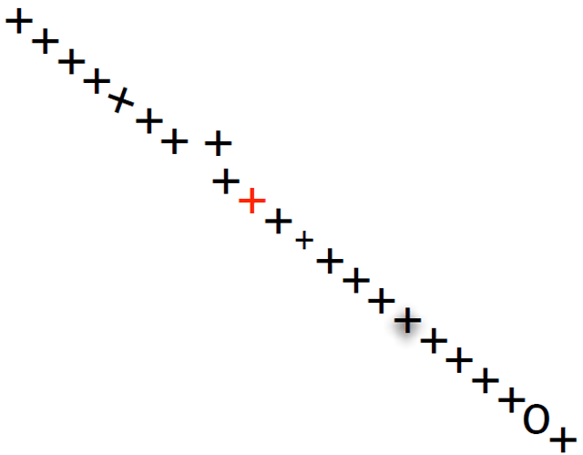
…and these attributes vary in their effectiveness
1
Position is the most powerful encoding.
The eye and brain are naturally wired to detect mis-alignment of the smallest order
2
Colour, when used in context, is powerful.
We can detect miniscule changes or variations in colour when comparing an element with neighbouring elements. This is what makes true colour (32-pixel colour, i.e. 4 billion) a necessity in computer graphics
3
Size is a useful differentiator.
The eye can detect moderate size variations at
moderate distances. Size also has a natural interpretation: that of priority.
4
Several other encodings are possible
Aesthetics such as angle, shadows, shapes, patterns, density, labelling, enclosures, etc. can each be used to map data.
Source: Designing Data Visualizations by Noah Iliinsky and Julie Steele (O’Reilly).
Copyright 2011 Julie Steele and Noah Iliinsky, 978-1-449-31228-2.

Slide 28
Let’s try visualizing two numbers 2 & 5

Slide 29
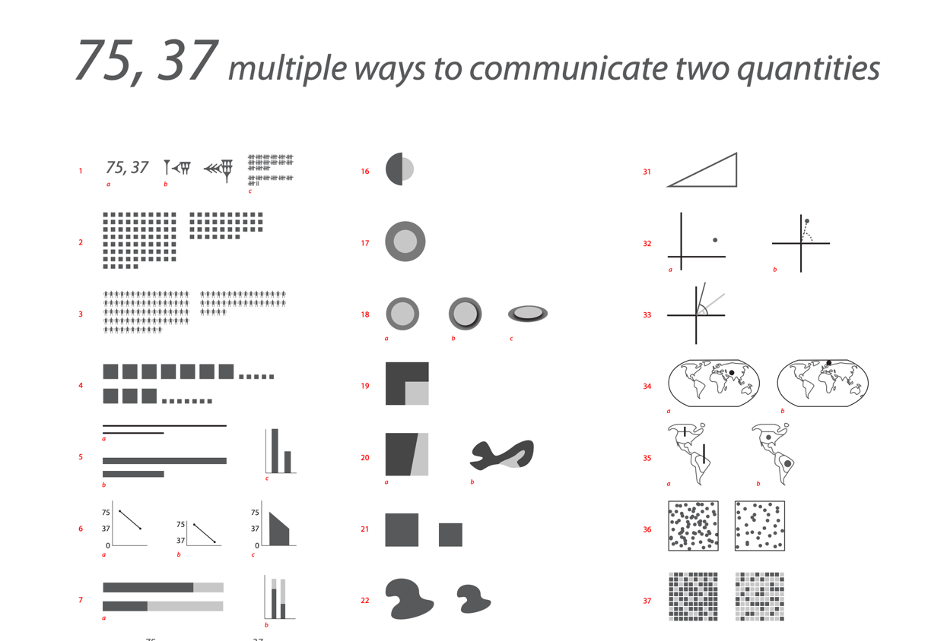
There are many ways to visualize just two numbers

Slide 30
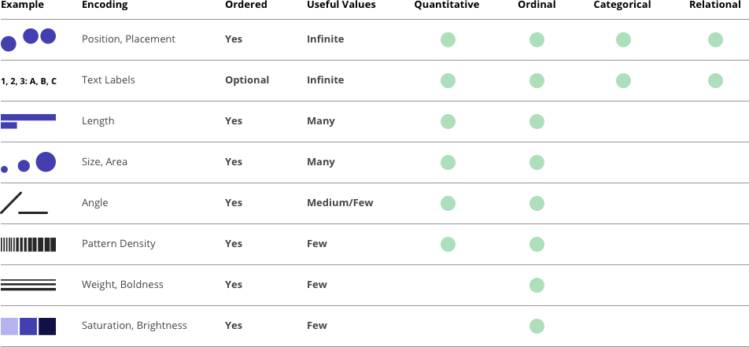
Properties and Best Uses of Visual Encodings
Noah Illinsky ComplexDiagrams.com/properties 2012-06
Notes:
This table shows the complete set of encodings ranked in the same order as the ease of processing by the brain. Their applicability across the different data properties of Quantitative, Ordinal, Categorical and Relational is shown.

Slide 31
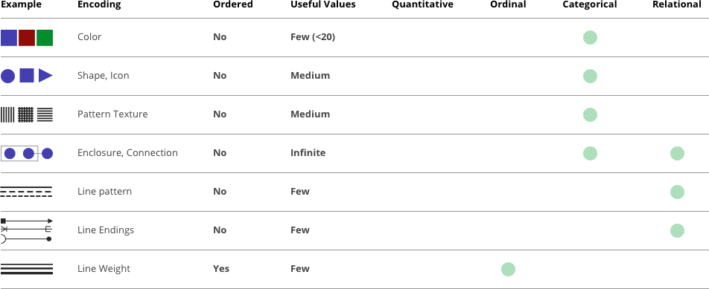
Properties and Best Uses of Visual Encodings
Noah Illinsky ComplexDiagrams.com/properties 2012-06

Slide 32
Some encoding methods are better* than others

Slide 33
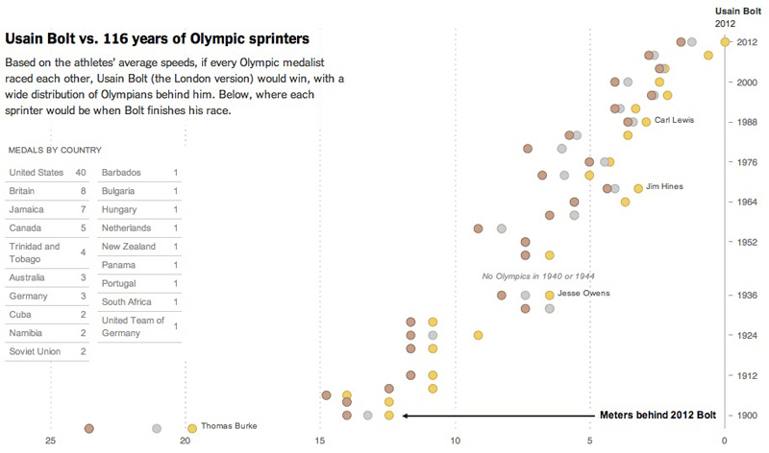
Examples - Visual encoding
COLOR
POSITION
TEXT LABEL

Slide 34
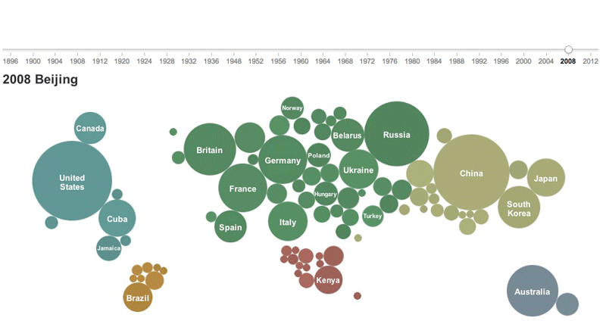
Examples - Visual encoding
Olympic Medals
COLOR
POSITION
TEXT LABEL
SIZE/AREA

Slide 35
Guidelines on Visual Encodings
List what you want to convey about the data. (remember the data relationships)
If multiple things, sort these in order of importance
Shortlist the pre attentive attributes that can be used for the above relationships.
Map these attributes to the messages.
Quick validation - self & with team

Slide 36
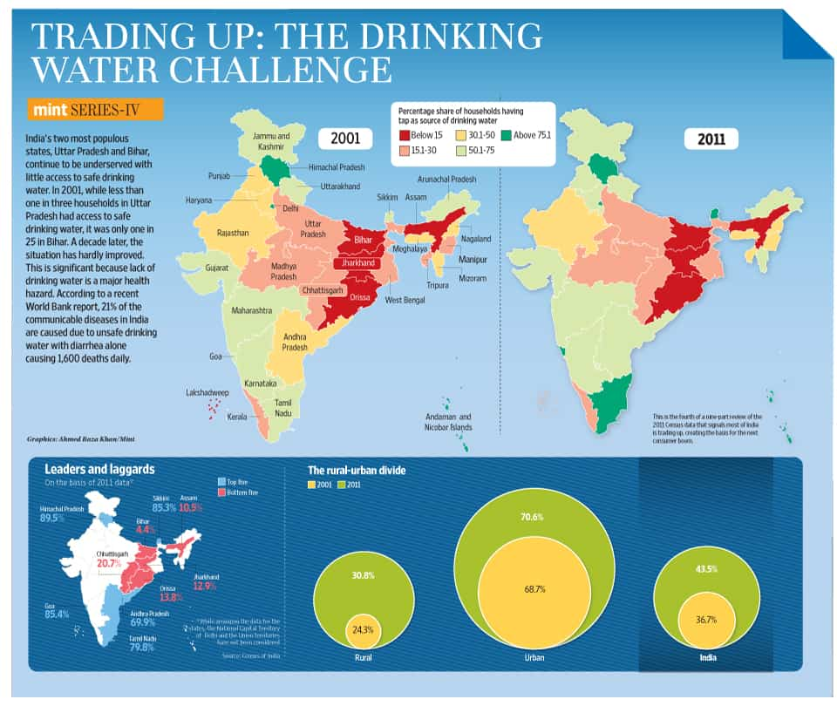
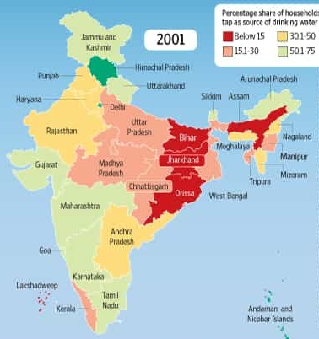
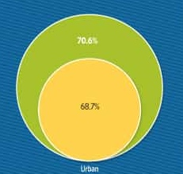
Example: Redesigning a chart on access to water
https://www.behance.net/gallery/14829307/Visualizing-Access-to-Drinking-Water-in-India

Slide 37
How do I get better at selecting charts?

Slide 38
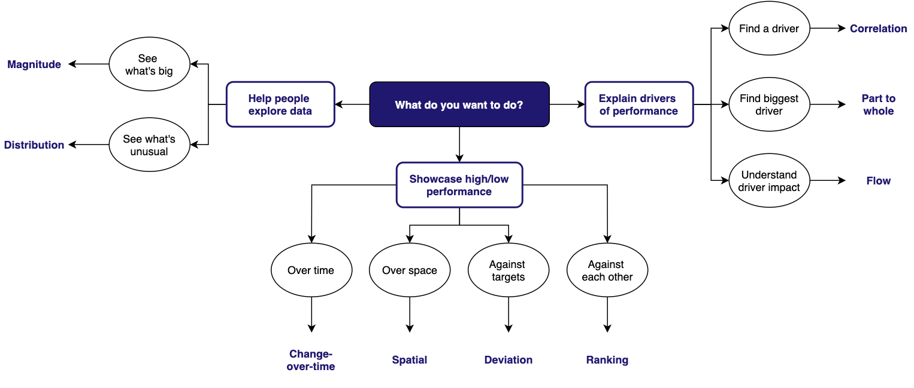
Pick a visual design based on the takeaway
Correlation
Magnitude
Part-to-Whole
Distribution
Flow
Change-over-Time
Spatial
Deviation
Ranking

Slide 39
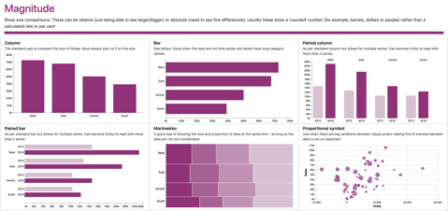
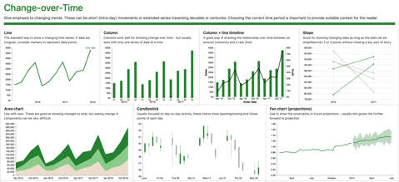
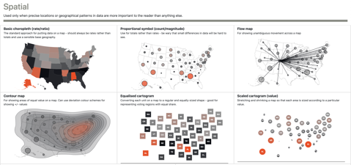
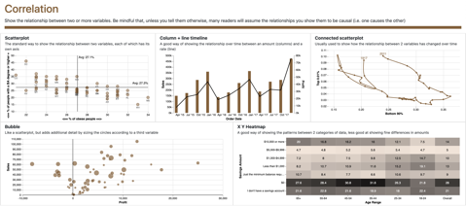
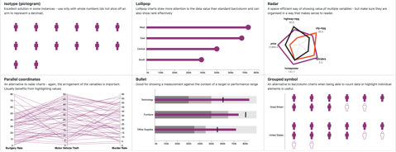
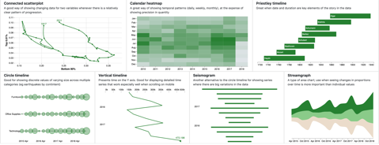
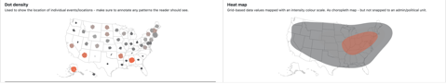
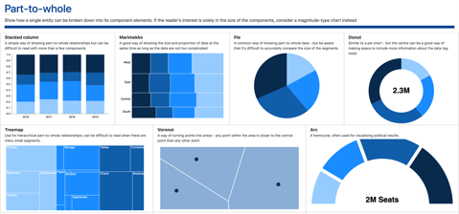
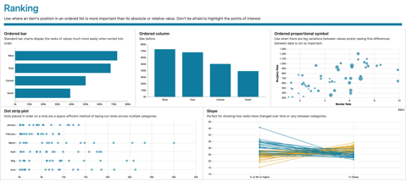
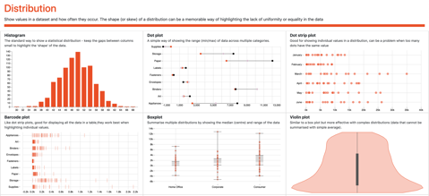
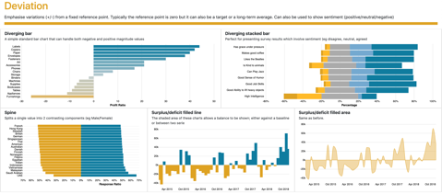
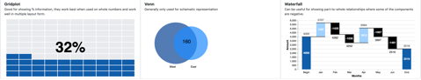
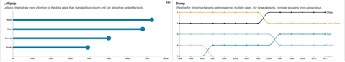
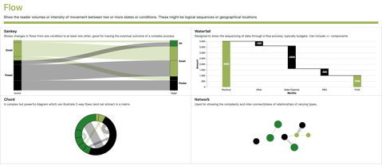
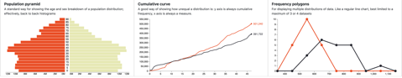
How the data should be interpreted decides the type of chart to be used
Help people explore data
Showcase high/low performance
Explain drivers of performance
Magnitude
Change-over-Time
Spatial
Correlation
Show size comparisons. These can be relative (just being able to see larger/bigger) or absolute (need to see fine differences).
Give emphasis to changing trends. These can be short (intra-day) movements or extended series traversing decades or centuries.
Used only when precise locations or geographical patterns in data are more important to the reader than anything else.
Show the relationship between two or more variables.
Part-to-Whole
Show how a single entity can be broken down into its component elements.
Ranking
Use where an item's position in an ordered list is more important than its absolute or relative value.
Distribution
Deviation
Show values in a dataset and how often they occur. The shape (or skew) of a distribution can be a memorable way of highlighting the lack of uniformity or equality in the data.
Emphasise variations (+/-) from a fixed reference point. Typically the reference point is zero but it can also be a target or a long-term average.
Flow
Show the reader volumes or intensity of movement between two or more states or conditions. These might be logical sequences or geographical locations
https://gramener.github.io/visual-vocabulary-vega/

Slide 40
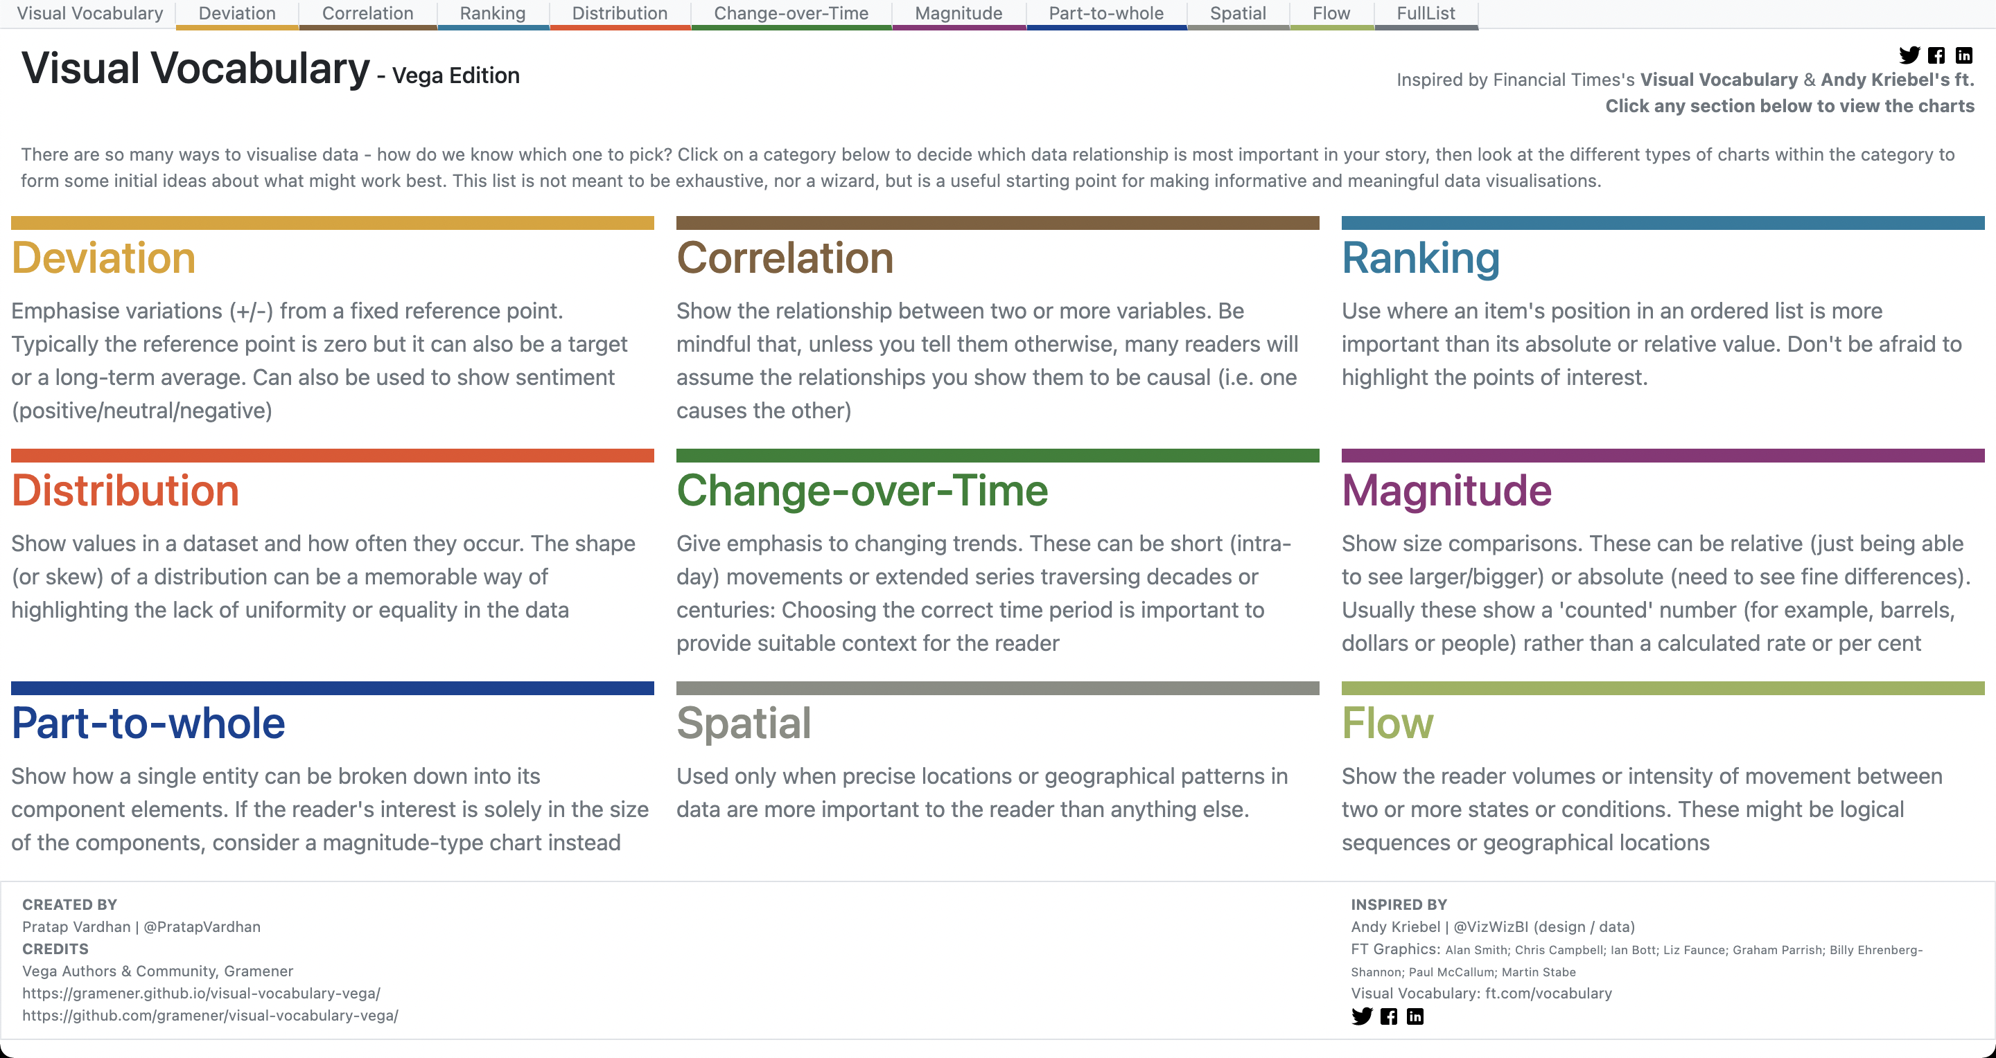
https://gramener.github.io/visual-vocabulary-vega/

Slide 41
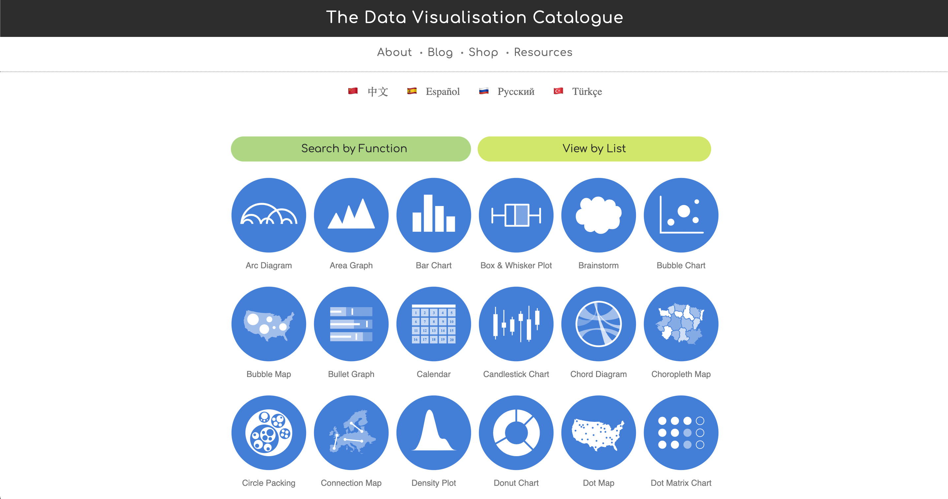
https://datavizcatalogue.com/

Slide 42
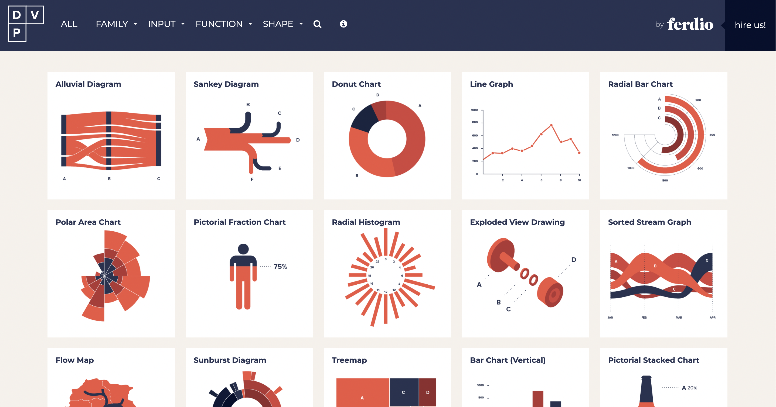
https://datavizproject.com/

Slide 43
How do I make sure audience notices the insights?

Slide 44
Class Xth English Marks Distribution
What’s the topic? Why is it important? What will you learn now?
Notes:
Specificity? Structure?

Slide 45
Annotate to explain & engage. Use four types of narratives
Summarize the visual in its title
Don’t describe the chart.
Don’t write the user’s question.
Write the answer itself. Like a headline.
Teachers add marks to stop some students from failing
What’s unusual
Large number of students score 35 marks.
Few (but not 0) students score between 30-35
This chart shows Class 10 students’ English marks in Tamil Nadu, India, in 2011. The X-axis has the mark a student has scored. The Y-axis has the # of students who scored that mark.
This is a bell curve. But the spike at 35 (the mark at which students pass) is unusual. Teachers must be adding marks to some of the students who are likely to fail by a small margin.
Explain & interpret the visual
How should the user read it?
What do you say when you talk through it?
Explain what the visual is. Then the axes. Then its contents. Then the inference.
# students
Large number of students score exactly 35 marks
Annotate essential elements
What should the user focus their eyes on?
Point it out, or highlight it with colors
Interpret what they’re seeing – in words.
No one scores 0-4 marks
Few (but not 0) students fail at 31-34 marks
Recommend an action
How should I act on this?
You need to change the audience.
(Otherwise, you made no difference.)
Marks
Only some students get this benefit.
Identify a fair policy that will be applied consistently.
Remember “SEAR”: Summarize, Explain, Annotate, Recommend

Slide 46
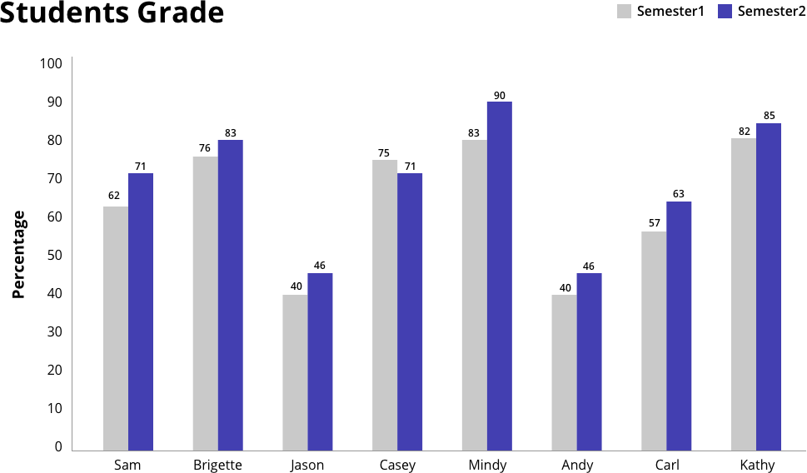
We can apply the same principles to the chart & surrounding elements
What’s the topic? Why is it important? What will you learn now?
A chart is supported by several elements to get context of the data & insight.
Each element has a scope to be well designed and help improve the comprehension of the chart.
Chart Title
Legends
Data Labels
Chart Area
Vertical Axis Label
Horizontal Axis
Vertical Axis
Vertical Axis Values
Horizontal Axis Values
Students
Horizontal Axis Label

Slide 47
In summary, here are the 9 steps to go from data to a data story
Who is your audience? They determine the story
What is their problem? That defines your analysis
Find the right analysis to solve the problem
Filter for big, useful, surprising insights
Start with the takeaway. Summarize your entire story
Add supporting analyses as a tree
Pick a format based on how your audience will consume the story
Pick a visual design based on the takeaway
Annotate to explain & engage. Use four types of narratives

Slide 48
Let’s try visualizing two numbers 2 & 5

Slide 49
How do I learn more?
Tools
Books
Paper & Pen (Collaborative)
Excel
Tableau & PowerBI
Raw graphs & Data Wrapper
Illustrator / Sketch / Figma
Truthful Art: Alberto Cairo
Storytelling with Data: Cole Knaflic
Resonate: Nancy Duarte
Dear Data: Stefanie Posavec & Giorgia Lupi

Slide 50
Session 4: Designing an Actionable Data Dashboard
Examples & difference from data stories

Slide 51
Explain: Data Story
Understand the audience & intent
Data is already collected.
Audience goals are defined.
Single story defined.
Find insights
Storyline
Design data stories

Slide 52
Explore: Static-data Dashboards
Understand the audience & intent
Data is fixed. Audience goals are fixed, but vary. There are a few key stories to tell.
Find key questions
List slices that lead to key stories
Structure the dashboard

Slide 53
But what about real-time data? Data keeps changing. Audience goals can vary. There will be different stories each time.

Slide 54
Explore: Real-time Dashboard
Understand the audience & intent
Data structure is fixed.
Key metrics are defined.
How many stories can we tell?
List questions that can give insights
Map out possible stories
Structure your dashboard

Slide 55
Thank you! Rasagy Sharma @rasagy / rasagy.in

